Slide 1
Loan Approval Prediction
Alvi - Laxman - Bishal- Kithimini
Samar_ Grp _1
23 Sept, 2025
MIT

Slide 2

MIT
Manual loan approval = slow, costly, inconsistent
Human judgment introduces bias
Growing demand for fast, fair, transparent loan approvals
Problem
Statement

Slide 3
MIT
Categorical Features
Gender, Married, Education, Dependents, Self_Employed, Property Area
Dataset
Overview
Numerical Features
ApplicantIncome, CoapplicantIncome, LoanAmount, Loan_Amount_Term, Credit_History
Loan Prediciton Dataset from kaggle
Target Variable
Loan_Status (Y = Approved, N = Rejected)
614
13
Rows
Column

Slide 4
MIT
Answered
Q1. Can we predict whether a loan should be approved?
Q2. Which features most influence loan approval?
Q3. How does loan approval vary with income-to-loan ratios?
Research Questions
Future Work
Q4. Would accuracy improve if external data (credit bureau, macroeconomic) were added?
Q5. Can deep learning models outperform classical ML approaches on this problem?
03
Notes:
TV-L1
- process small portions of video frame and gets optical flows from them, more fine and granular
limitation - high fluctuation in intensity and very rapid movement cant be caught

Slide 5
MIT
🟡 Data quality
📊 Small sample size
⚖️ Imbalanced classes
📈 Skewed features
🤔 Accuracy vs Explainability
Challenges
04
Notes:
TV-L1
- process small portions of video frame and gets optical flows from them, more fine and granular
limitation - high fluctuation in intensity and very rapid movement cant be caught

Slide 6
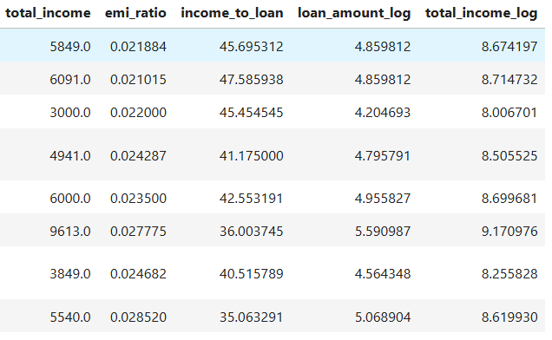
MIT
Cleaning
Imputed missing values (median for numeric, mode for categorical)
Dropped Loan_ID (not useful for prediction)
Preprocessing
Ratios
Total Income = Applicant + Co-applicant
EMI Ratio = LoanAmount / TotalIncome
Income-to-Loan Ratio = Total_Income / LoanAmount
total_income_log
Notes:
TV-L1
- process small portions of video frame and gets optical flows from them, more fine and granular
limitation - high fluctuation in intensity and very rapid movement cant be caught

Slide 7
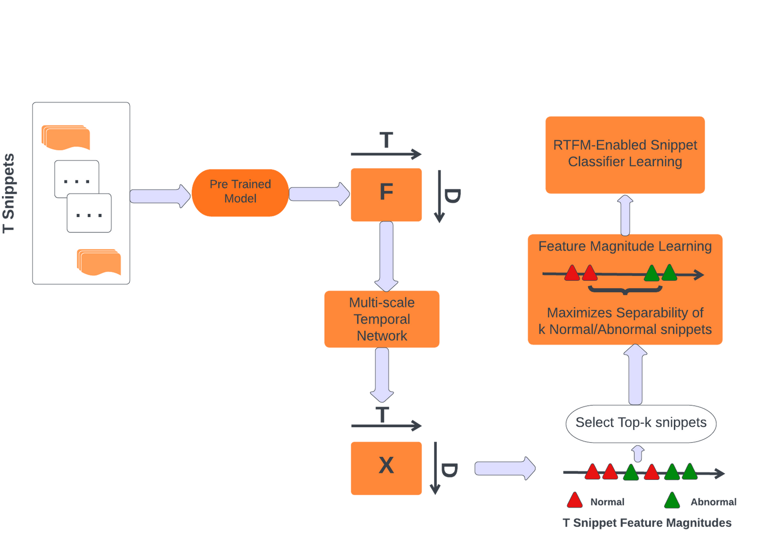
Pulchowk Campus
Methodology
MIT
System Block Diagram
Algorithms
Logistic Regression
Gradient Boosting
Random Forest
Decision Tree
XGBoost
05

Slide 8
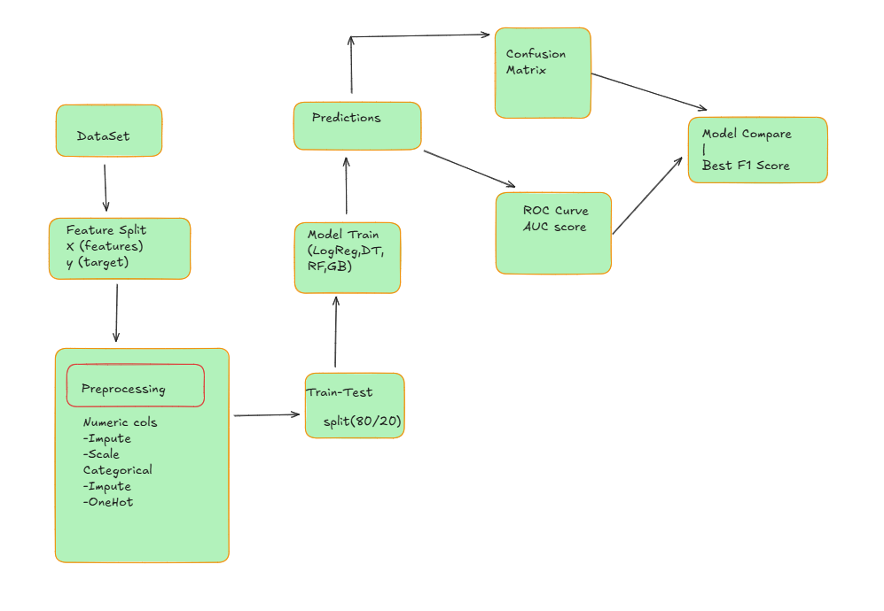
Workflow

Slide 9
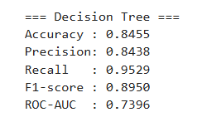
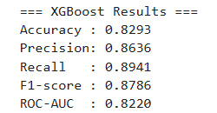
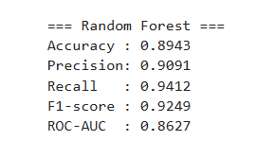


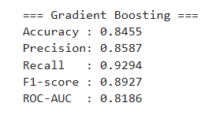
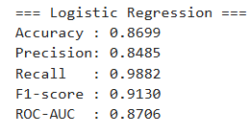
Results & Insights
Model Comparison

Slide 10
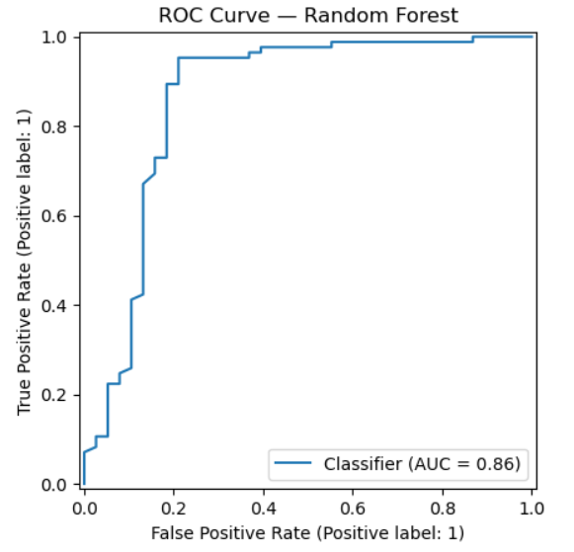
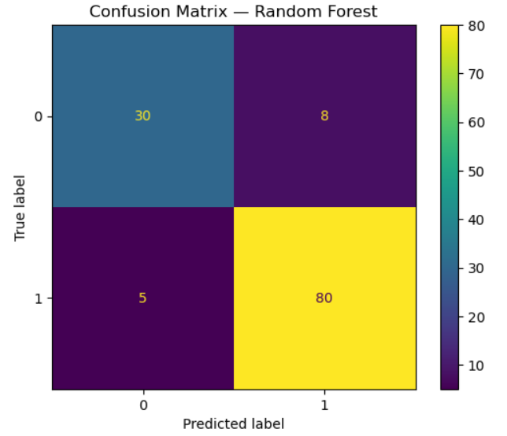
Random Forest

Slide 11
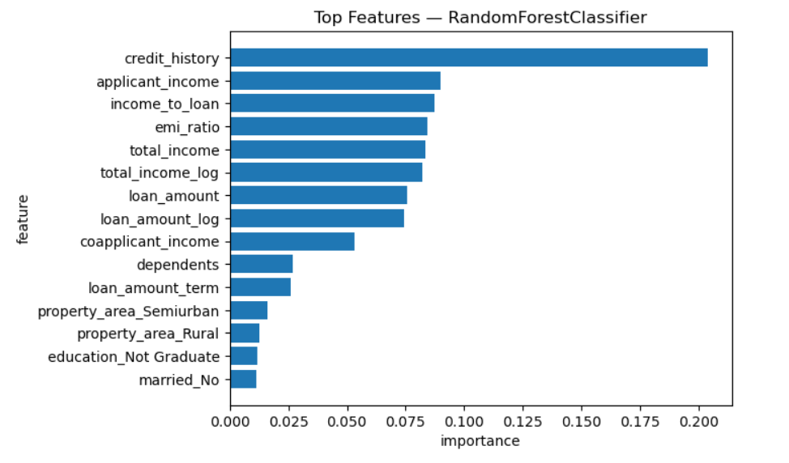
Credit History → strongest predictor
Loan Amount & Income → moderate influence
EMI Ratio → affordability indicator
MIT
Key Features
Notes:
TV-L1
- process small portions of video frame and gets optical flows from them, more fine and granular
limitation - high fluctuation in intensity and very rapid movement cant be caught

Slide 12
MIT
01
Applicants with good credit history have far higher approval rates.
02
Balanced income-to-loan ratios lead to higher approval likelihood.
Insights
03
Too high EMI ratios reduce approval chances.
04
Machine Learning (esp. Random Forest) improves prediction fairness & consistency compared to manual approval.

Slide 13
MIT
01
Machine Learning improves accuracy, efficiency, and fairness in loan approvals
Conclusion
02
Random Forest achieved the best overall performance (Acc ~89%, F1 ~0.92)
Limitations
03
Confirms importance of credit history and income-to-loan ratio in decisions
614
Small dataset
614 records → limited generalisation
Rows
Missing key financial info
Credit bureau data, detailed repayment history

Slide 14
Data Expansion
Integrate credit bureau data and additional financial attributes
Use larger datasets for better model generalisation
Advanced Models
Explore Deep Learning architectures (ANNs, LSTMs)
Compare with classical ML models for performance gains
Future Work
System Deployment
Build a real-time loan approval system for banks
Improve fairness & transparency in decision-making

Slide 15
Thank You
Contact us for more!
Alvi Hossain Safri Himalya
Laxman Kunwar
Bishal Gautam
Kithmini Nimasha

